Slide 1
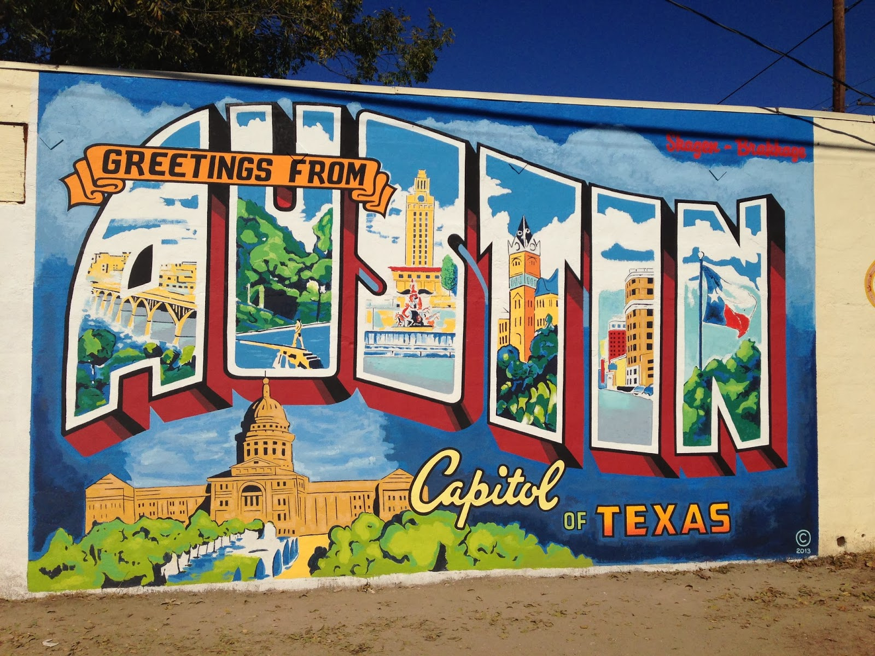
Picture This
Explore without Expense

Slide 2
Pranav Rayuda
Danny Perille
Shristi Chitlangia
Kevin Jacob
Alex DeJong
Alexy

Slide 3
Introduction

Slide 4
Introduction
Solution

Slide 5
Introduction
Solution
Implementation

Slide 6
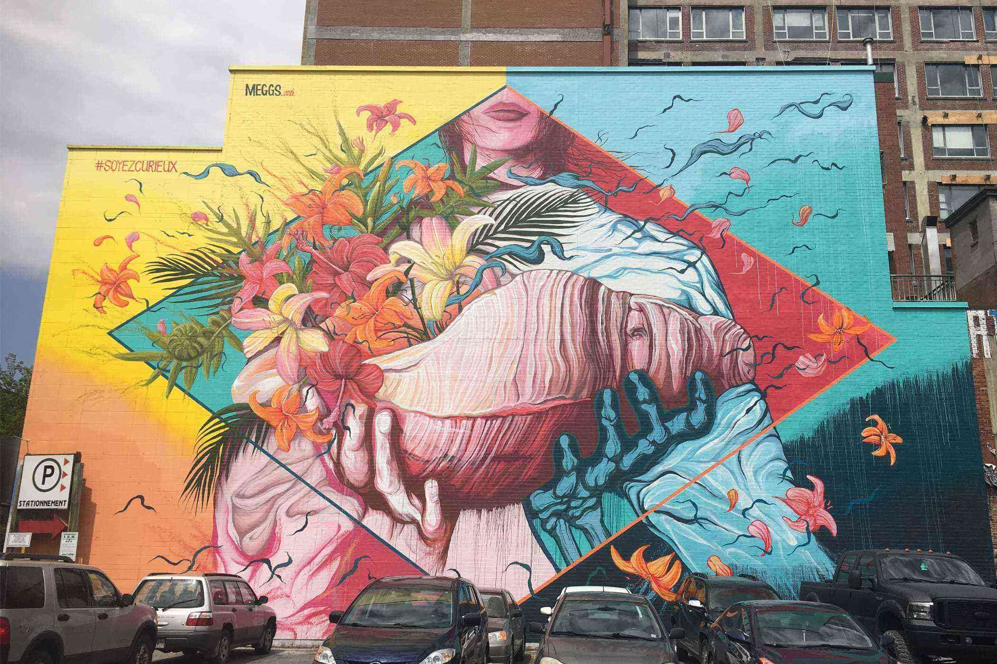
Introduction

Slide 7
Introduction

Slide 8
Introduction

Slide 9
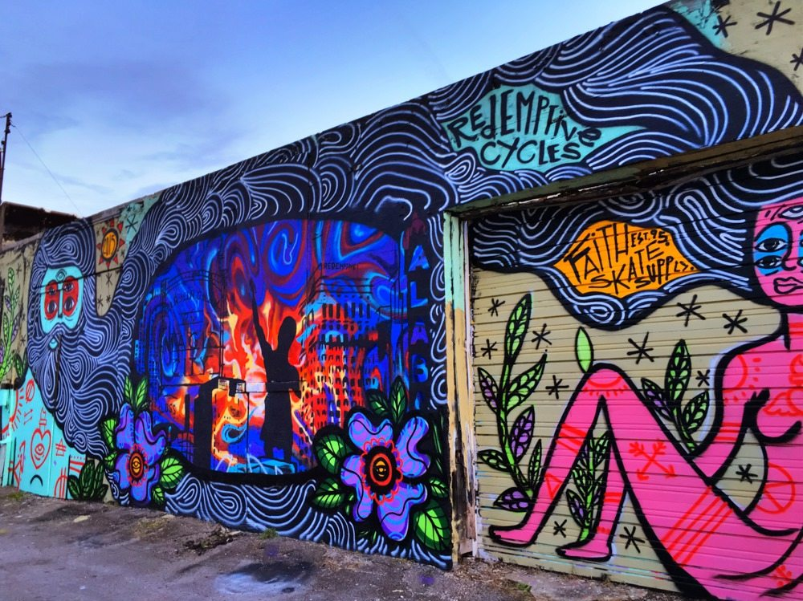
This Photo by Unknown Author is licensed under CC BY-NC-ND
Solution

Slide 10
Introduction
Solution

Slide 11
Introduction
Solution

Slide 16
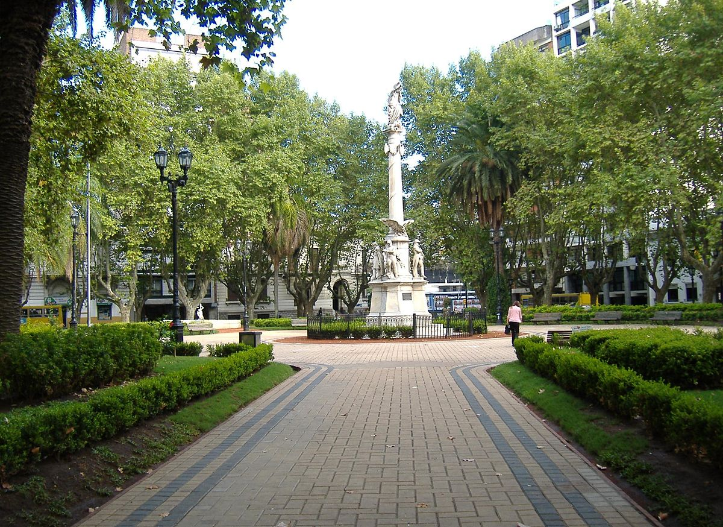
Implementation

Slide 17
How it Works
Introduction
Solution
Implementation

Slide 18
Target Audience
Marketing (Ill make it perty later)
17-35
Mobile Middle
35-55
Middle Aged Movers
Social Media
Similar Products
Introduction
Solution
Implementation

Slide 19
Conclusion

Slide 20
Why PictureThis! ?
Introduction
Solution
Implementation
Conclusion

Slide 22
Covid Crisis
This app will be a prime post covid application.
DISCLAIMER: Due to COVID 19 and the social-distancing guidelines recommended by the CDC, uses of the app will be limited to local remote areas, and locations marked as higher areas of interests and hotspots will need to be currently avoided.
Introduction
Solution
Implementation
Conclusion

Slide 23
Value Proposition
While other products exist to crowdsource tourism (eg. TripAdvisor), our product is different in a number of ways. First, we allow for temporary attractions in addition to permanent ones, so users don't miss out on limited time events (eg. an art showcase in the park). Additionally, since our data is uploaded directly by users in the area, it gives a more true sense of someone who lives/visits that area would actually do. That way, we get a more varied mix of tourist spots and more unknown local attractions to fit any user's needs. Finally, our app showcases attractions popular in a smaller window of time, meaning it better reflects changing interests and seasonal nature of some attractions which is not reflected on most tourism sites.
Introduction
Solution
Implementation
Conclusion

Slide 24
Marketing
Key Partners:
Travel influencers (youtube, instagram)
Local venues/businesses
People in any given area -- if they don't
upload anything, app is useless
Introduction
Solution
Implementation
Conclusion

Slide 25
Financial
Cost Structiure:
Server to host uploaded data (~$300/month for cloud server)
Google Maps API is currently free, though subject to change to be $ per request
Advertising -- especially high early, as we need data to convince anyone to use it
Employees to monitor data
Revenue Streams:
Advertisements - attractions in the area can pay to have a pin for their location
Freemium - free version allows users to choose one small location radius; premium version gives access
to entire map (making sure they don't just redownload app is a problem)
Introduction
Solution
Implementation
Conclusion

